Slide 1

Study on Stock Market Trading and Strategy Development for EV Stocks Using DQN and Double-DQN Reinforcement Q-Learning Models
CSC-792: Reinforcement Learning Project
Alisha Karna, Madhavi Awasthi, Pramesh Baral,
Pramod Acharya, and Randhir Kumar Yadav
05/04/2023

Slide 2
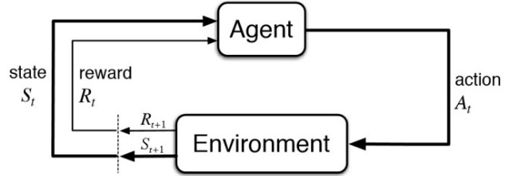
Introduction
Deep Reinforcement Learning Model for Stock Trading
RL is a type of ML that allows agents to learn how to behave in an environment by trial and error.
RL integrated with Deep Learning (DL) can solve decision-making problems in financial markets.
A combination of DL and RL techniques can be used to train an agent that can learn from its interactions with the stock market environment and take actions that maximize long-term gains.
Deep Q-Network (DQN) integrates Q-learning and deep neural networks to choose actions that optimize a cumulative reward signal over time.
Double Deep Q-Network (Double DQN) addresses the problem of overestimation of Q-values in DQN by using two separate neural networks for action selection and Q-value estimation.
1

Slide 3
Motivation
Predicting stock prices in the dynamic and complex EV market can be challenging.
Traditional methods such as technical and fundamental analysis have limitations.
Offer new insights into how Reinforcement Learning algorithms can help investors navigate this dynamic market with confidence.
Show that deep reinforcement learning algorithms hold promise for developing effective trading strategies in the stock market, particularly for emerging sectors such as the EV industry.
2

Slide 4
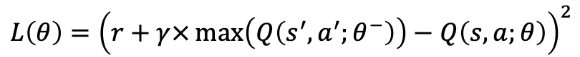
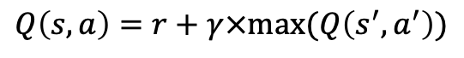
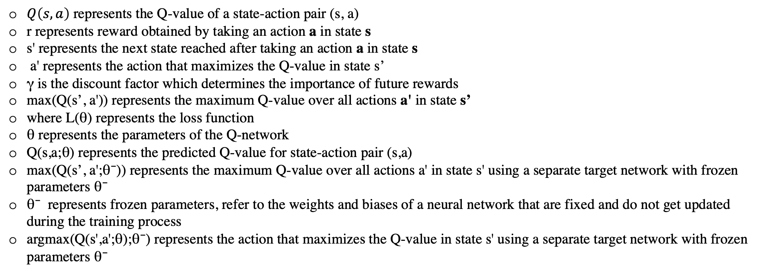
Mathematical Representation for DQN and DDQN Model
DQN Model
$$L\left(θ\right)={\left(r+γ×\max\left(Q\left(s^{′},a^{′};θ^{−}\right)\right)−Q\left(s,a;θ\right)\right)}^{2}$$
$$Q\left(s,a\right)=r+γ×max⁡(Q\left(s^{′},a^{′}\right))$$
DDQN Model
$$L\left(θ\right)={\left(r+γ×Q\left(s^{′},argmax\left(Q\left(s^{′},a^{′};θ\right);θ^{−}\right)\right)−Q\left(s,a;θ\right)\right)}^{2}$$
$$Q\left(s,a\right)=r+γ×Q\left(s^{′},argmax\left(Q\left(s^{′},a^{′};θ\right)\right);θ^{−}\right)$$
$Q\left(s,a\right)$ represents the Q-value of a state-action pair (s, a)
r represents reward obtained by taking an action a in state s
s' represents the next state reached after taking an action a in state s
a' represents the action that maximizes the Q-value in state s’
γ is the discount factor which determines the importance of future rewards
max(Q(s’, a')) represents the maximum Q-value over all actions a' in state s’
where L(θ) represents the loss function
θ represents the parameters of the Q-network
Q(s,a;θ) represents the predicted Q-value for state-action pair (s,a)
max(Q(s’, a';θ⁻)) represents the maximum Q-value over all actions a' in state s' using a separate target network with frozen parameters θ⁻
θ⁻ represents frozen parameters, refer to the weights and biases of a neural network that are fixed and do not get updated during the training process
argmax(Q(s',a';θ);θ⁻) represents the action that maximizes the Q-value in state s' using a separate target network with frozen parameters θ⁻
3

Slide 5
The study compared the performance of DQN and DDQN DRL models through computational analysis and simulated trading.
Each stock was split into a training and testing set for the models' input.
The benefits of the two models were compared, and findings were based on simultaneous analysis of training and test results.
Differences between DQN and Double DQN models
DQN
Uses a single neural network to estimate Q-values for all state-action pairs
The target Q-values used in the loss function are based on the same network being trained
Can result in overestimation of Q-values due to the maximization operation performed on the same set of parameters used to estimate Q-values
Double DQN
Uses two neural networks, a main Q-network and a separate target network, to estimate Q-values
The target Q-values used in the loss function are based on the target network with frozen parameters
Can reduce overestimation of Q-values by using a separate network to select actions and estimate Q-values for the next state
Other differences may include the following:
Double DQN may require additional hyperparameter tuning for the learning rate and update frequency of the target network
Double DQN may require more computational resources due to the use of two networks
Double DQN may require additional implementation steps for creating and updating the target network
4

Slide 6
Datasets and Resources
Data collected from Yahoo Finance, https://finance.yahoo.com/
Includes day-to-day opening and closing prices, highest and lowest values per unit stock
Four different electric vehicle stocks: Tesla ($TSLA), General Motor ($GM), Nio ($NIO), and BYD Company ($BYDDY), listed on the New York Stock Exchange (NYSE)
Data covers the period from January 2nd, 2020 to December 29th, 2022
Data was cleaned and pre-processed after collection.
5

Slide 7
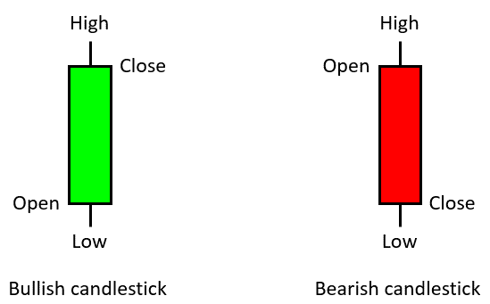
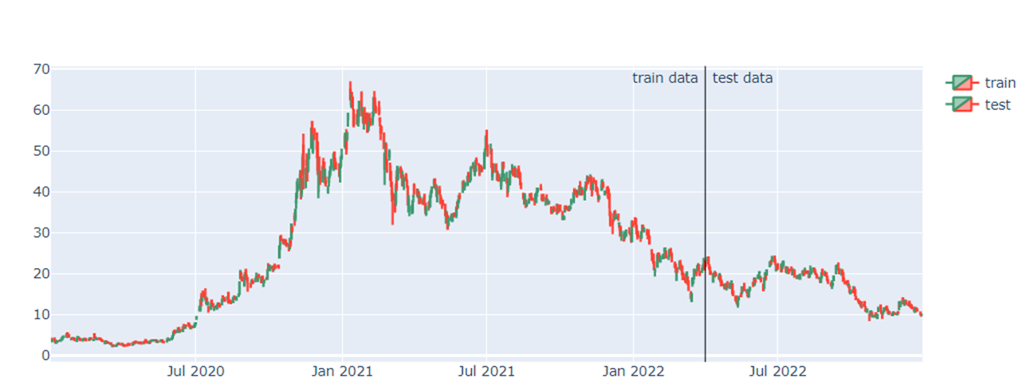
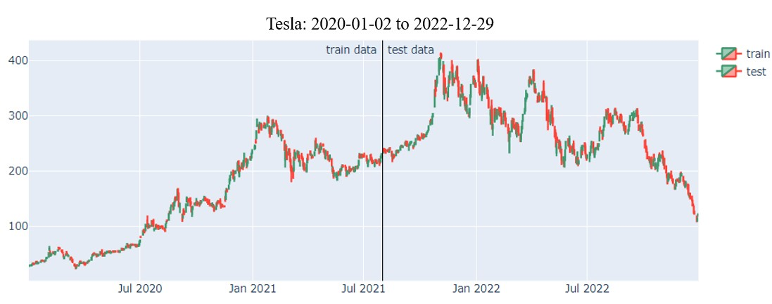
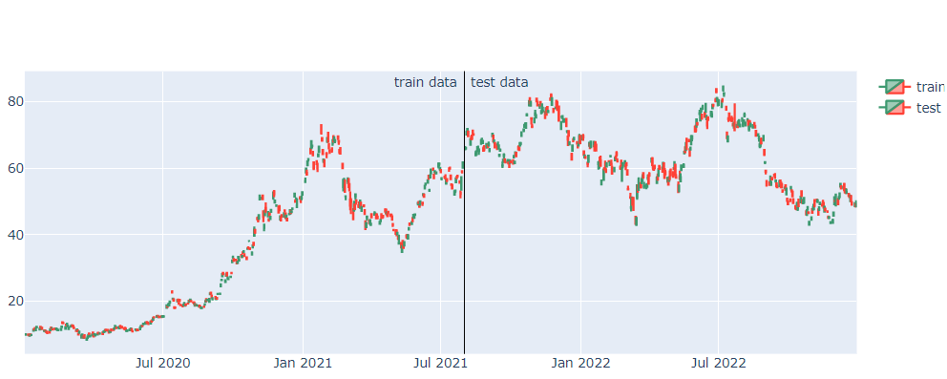
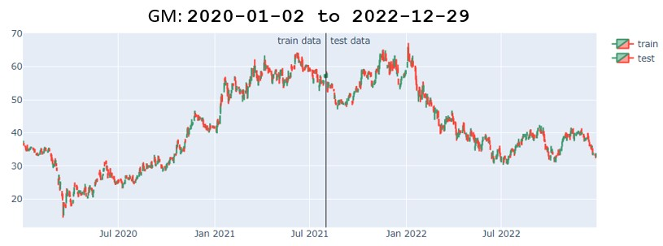
Datasets Trend
6

Slide 8
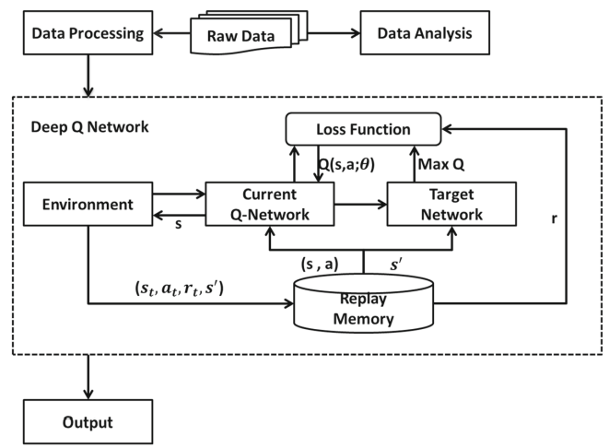
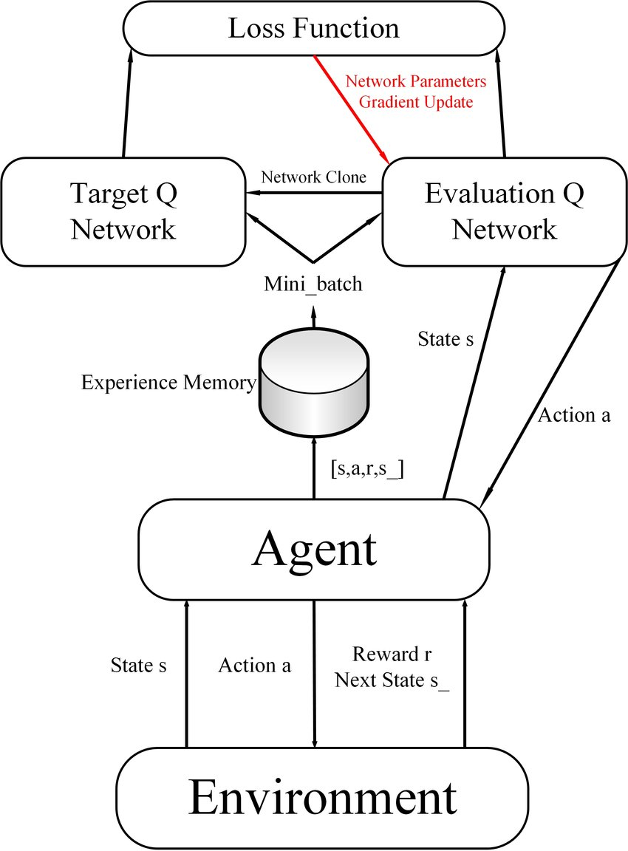
Methodology / Model Overview
DQN uses a neural network to predict Q value and updates the neural network to learn the max Q value
DQN has two neural networks: Target-Network with fixed parameters for obtaining target value and Current Q-Network for evaluating Current Q value
Training data is randomly extracted from Replay Memory, which records actions (a), rewards (r), and results of the next state (s, a, r, s’)
Networks update their parameters regularly and Replay Memory changes accordingly
The Loss function is the result of subtracting the value of Q in Target-Network from the value of Q in Current Q-network.
The values between modules are changed iteratively until the optimal value of Q is achieved.
DQN
DDQN
DDQN address the overestimation of Q-values that can occur in the original DQN.
In DDQN, two separate neural networks are used to estimate the Q-values. One network is used to select the actions while the other is used to evaluate the Q-values.
7

Slide 9
Model Implementation
Hyperparameters used to configure the Q-network, the replay memory, the training procedure, and the exploration-exploitation trade-off during training.
The specific values used for these hyperparameters were chosen based on empirical experiments
DQN Model
Input size: The size of the input to the Q-network, which is the number of historical timesteps plus one (env.history_t + 1).
Hidden size: The number of hidden units in the two hidden layers of the Q-network (100).
Output size: The size of the output of the Q-network, which is the number of possible actions (3).
Epoch Num: The number of training epochs (50).
Step max: The maximum number of steps in each episode (length of the input data - 1).
Memory Size: The maximum number of experiences stored in the replay memory (200).
Batch Size: The number of experiences sampled from the replay memory in each training iteration (20).
Epsilon: The initial value of the exploration rate (1.0).
Epsilon Decrease: The rate at which the exploration rate decreases (1e-3).
Epsilon min: The minimum value of the exploration rate (0.1).
Start reduce Epsilon: The number of steps after which the exploration rate starts decreasing (200).
Train Freq: The frequency at which the Q-network is updated (every 10 steps).
Update Q Freq: The frequency at which the target Q-network is updated (every 20 steps).
Gamma: The discount factor used in the Q-learning update (0.99).
Show log Freq: The frequency at which training progress is logged (every 5 epochs).
8

Slide 10
DDQN Model
Input size: Number of input neurons in the Q network, which is the number of historical time steps+1 (env.history_t + 1).
Hidden size: 100.
Output size: the number of output neurons in the Q network, which is equal to the number of possible actions ( 3).
Epoch Num: 50
Step max: (length of the input data - 1).
Memory Size: 200.
Batch Size: the number of experiences sampled from the replay memory to update the Q network, which is set to 50.
Epsilon: the exploration rate used for the epsilon-greedy policy, which is set to 1.0 (fully exploratory) at the beginning of training and gradually decreased to epsilon_min.
Epsilon Decrease: the amount by which epsilon is decreased after each step, which is set to 1e-3.
Epsilon min: the minimum exploration rate, which is set to 0.1.
Start reduce Epsilon: the number of steps after which epsilon starts to decrease, which is set to 200.
Train Freq: the frequency (in steps) at which the Q network is updated, which is set to 10.
Update Q Freq: the frequency (in steps) at which the target Q network is updated with the Q network, which is set to 20.
Gamma: the discount factor used to discount future rewards, which is set to 0.99.
Show log Freq: the frequency (in epochs) at which the training progress is logged, which is set to 5.
During training, agent interacts with the environment, stores experiences in the replay memory, and periodically updates the Q network using mini-batch gradient descent with mean squared error loss.
Target network is periodically updated to the current Q network to stabilize training. The exploration rate is decreased over time to shift the agent from exploration to exploitation.
Finally, the training progress is logged every few epochs to monitor the agent's performance.
9

Slide 11

Results
Test profit is higher than train profit
Results are better than traditional human decision-making
Proved that DRL can be used in stock market decision-making
DRL model is applicable to most stocks with sufficient information
10

Slide 12
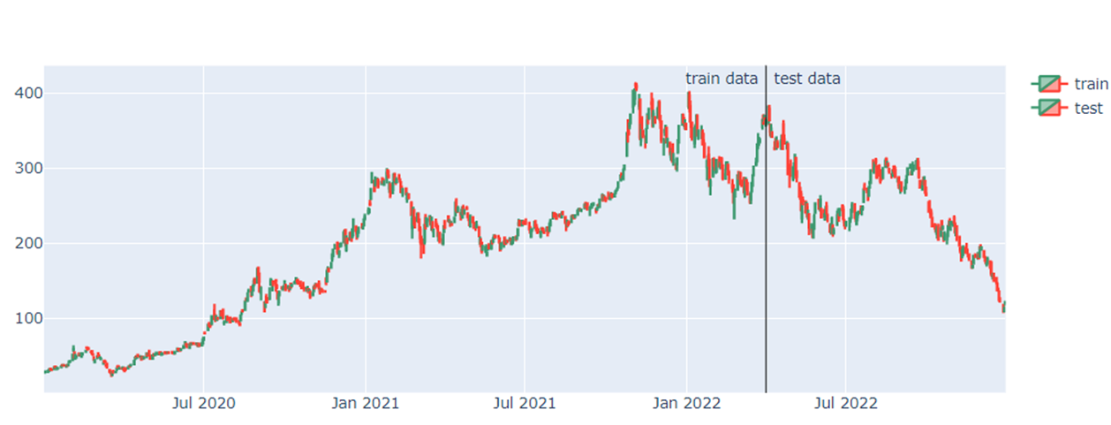
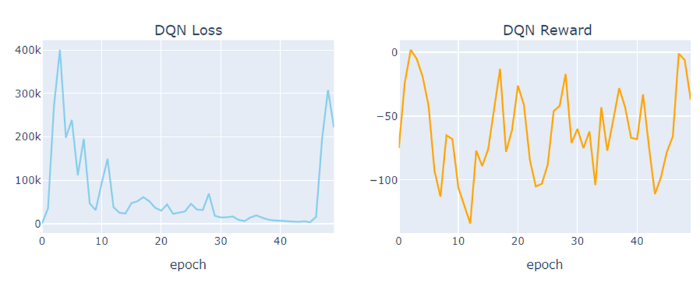
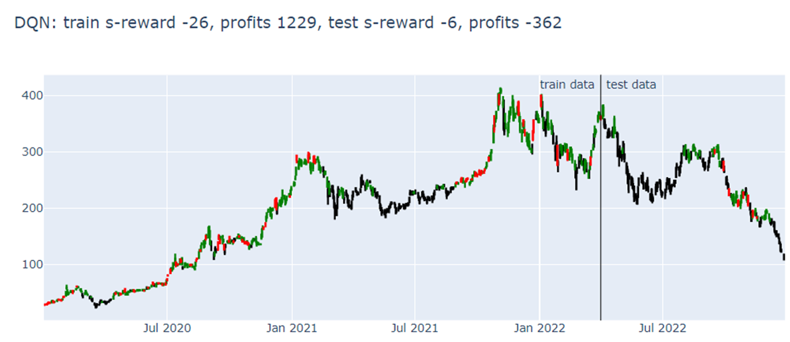
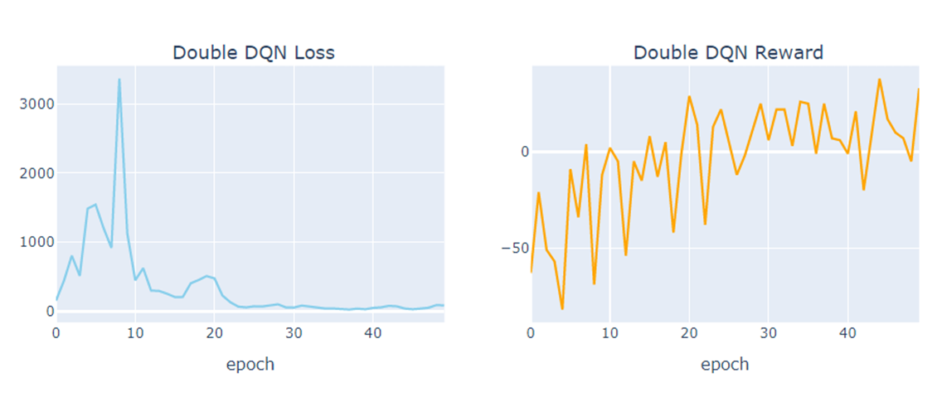
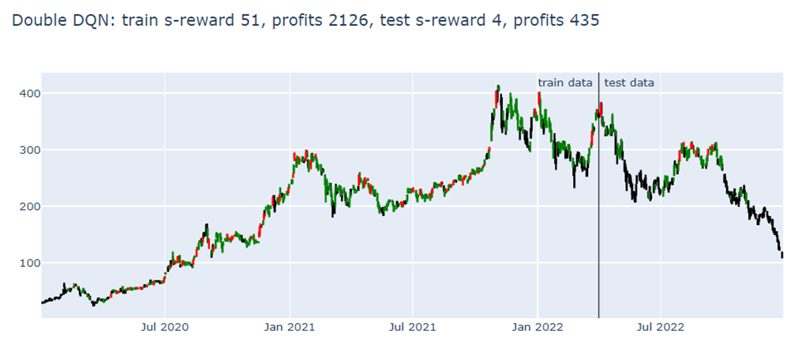
Tesla: 2020-01-02 to 2022-12-29
11

Slide 13
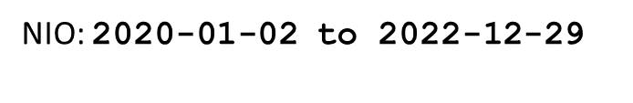
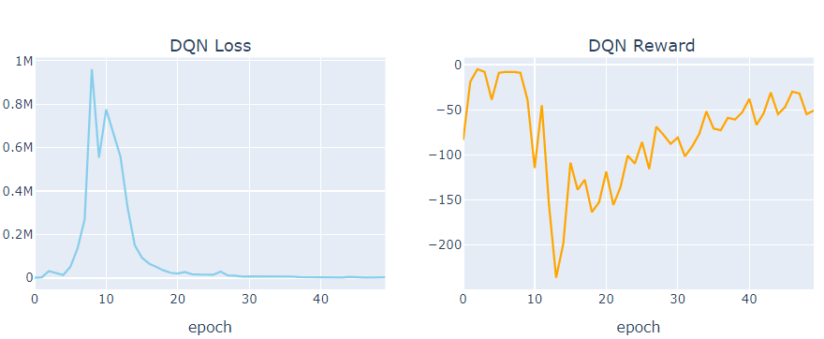
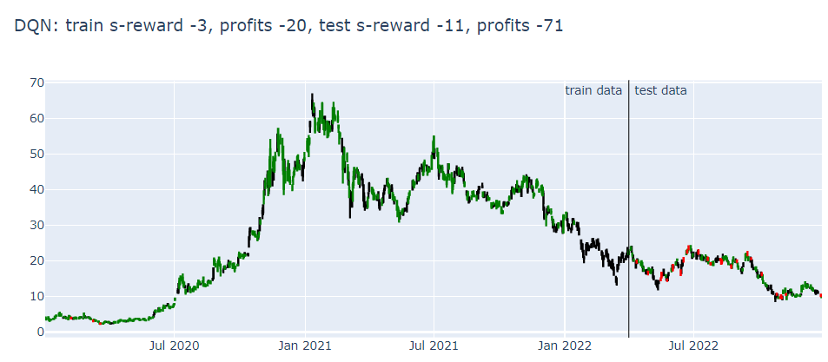
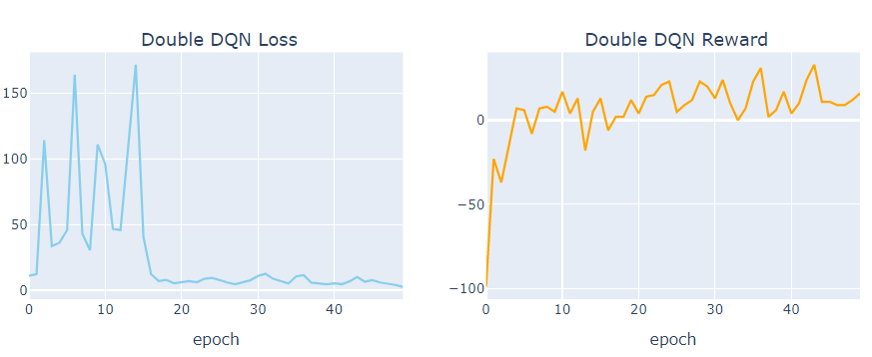
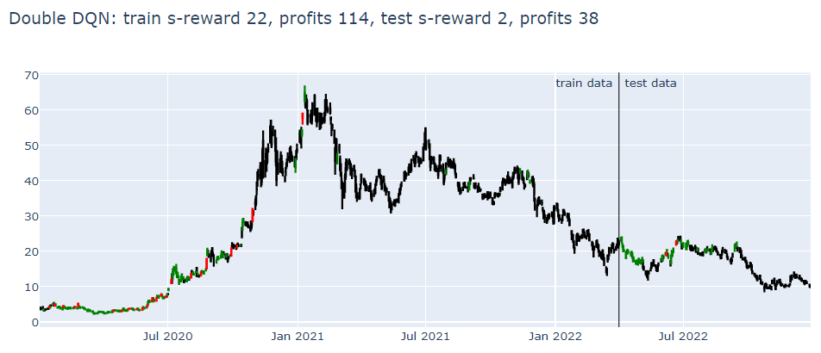
12

Slide 14
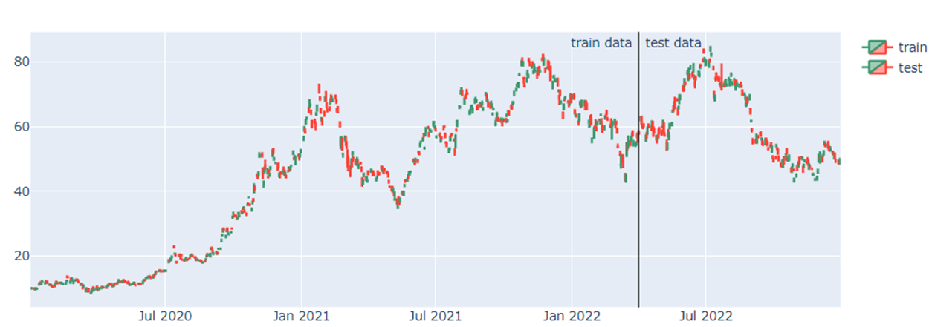
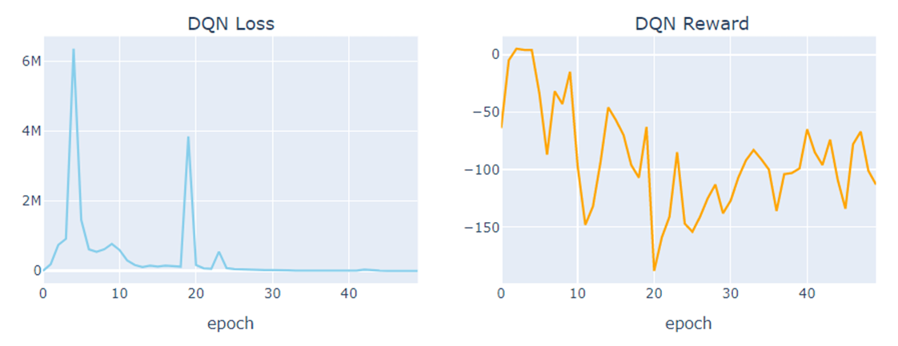
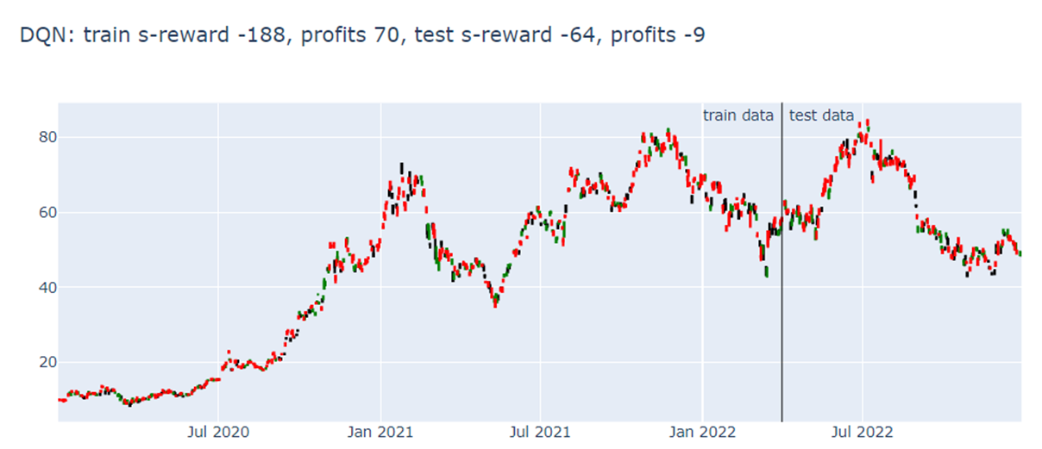
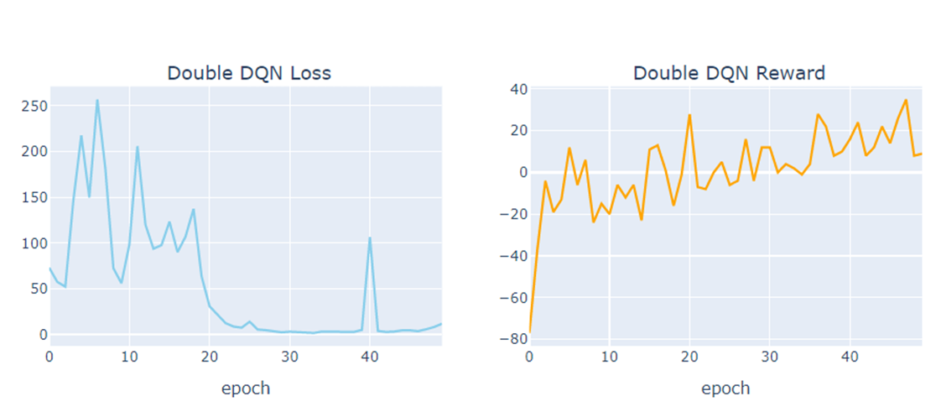
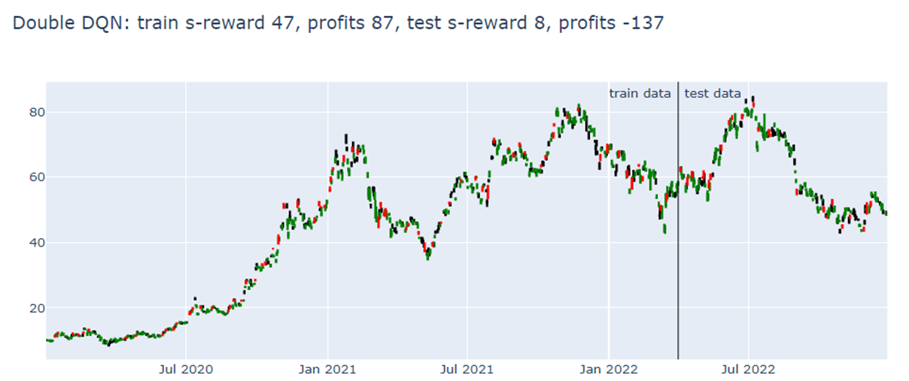
BYDDY: 2020-01-02 to 2022-12-29
13

Slide 15
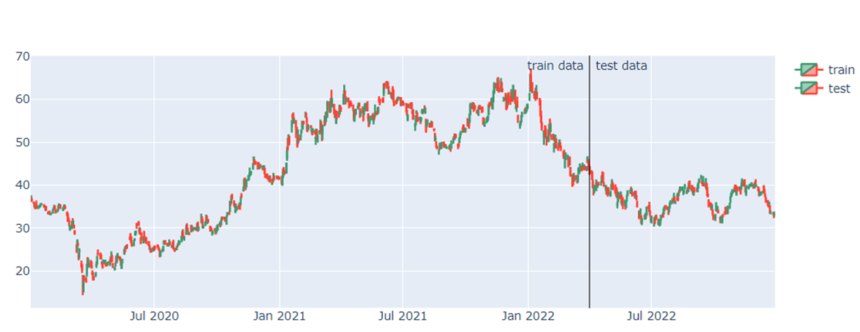
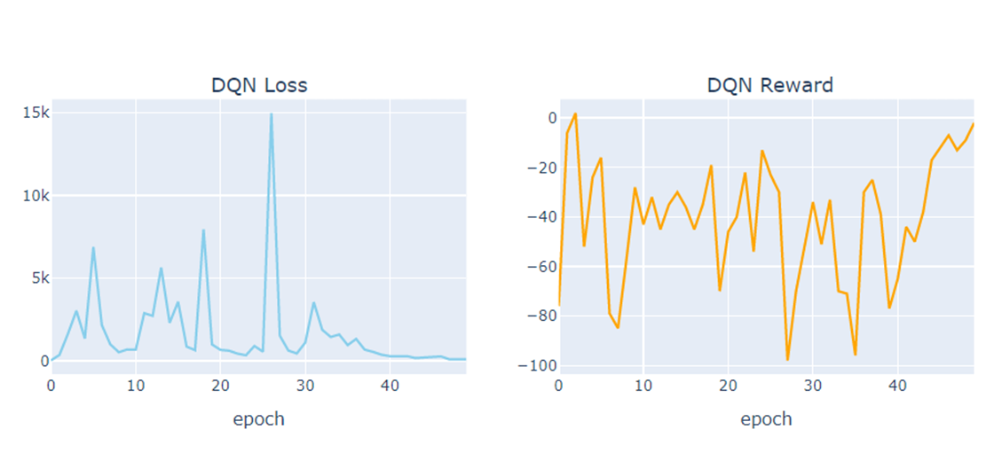
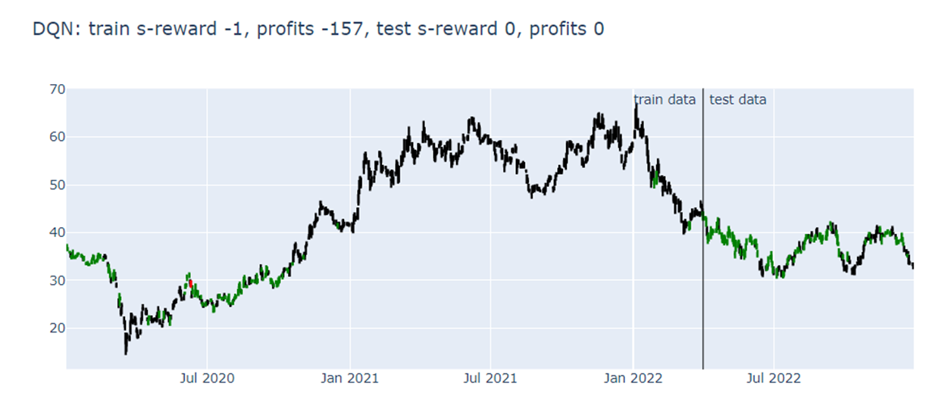
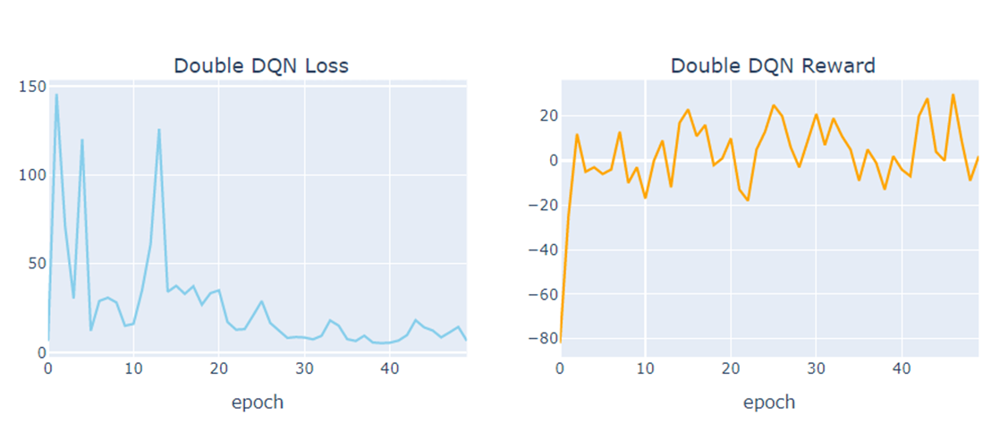
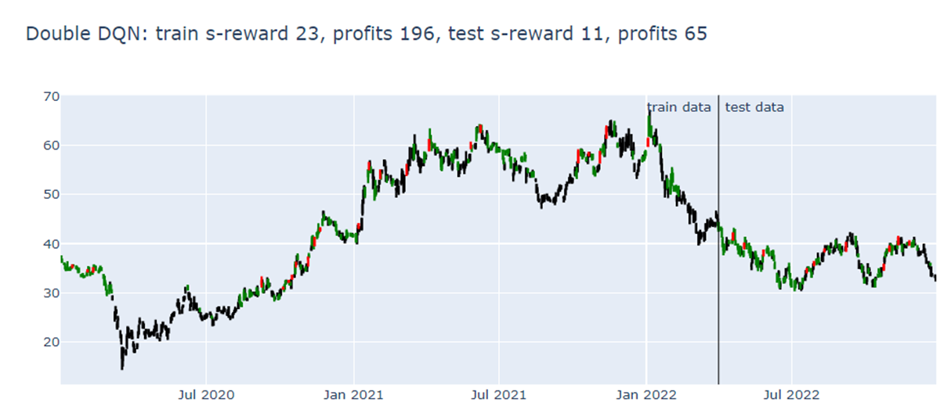
GM: 2020-01-02 to 2022-12-29
14

Slide 16
Results Summary
15

Slide 17
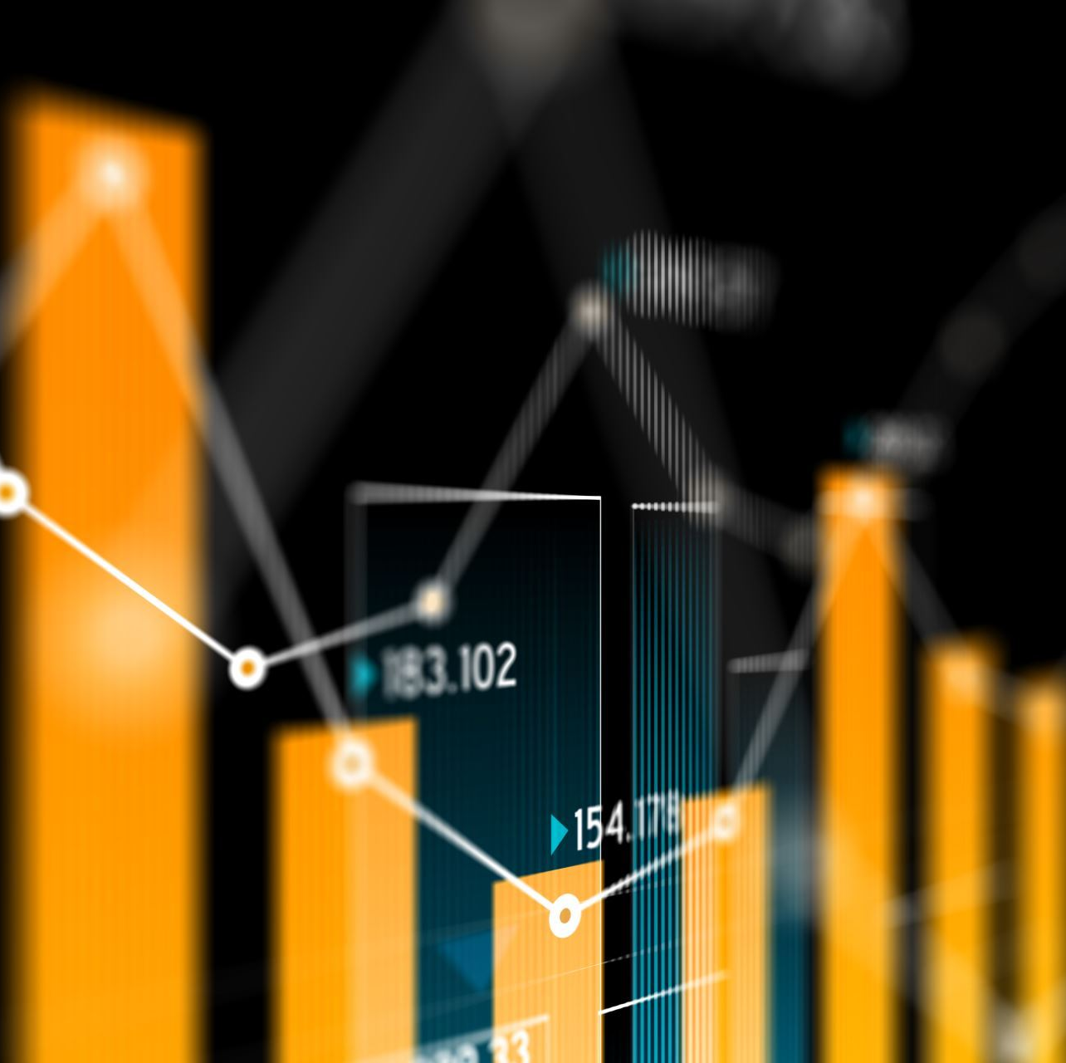
Conclusion
Practicality of DRL in stock market decision-making
Several advantage over traditional transactions
Insufficient data could bring instability to the experiment
Theory is still immature and there are many challenges ahead
Future enhancements
16

Slide 18
Thank You

